Slide 1
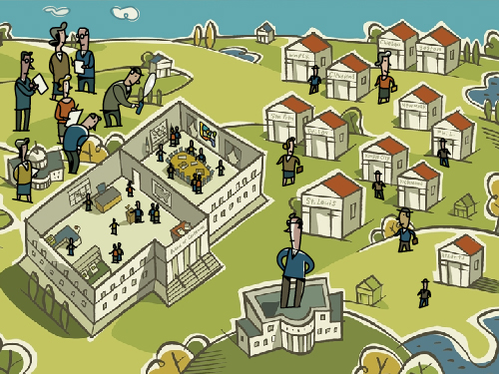
The Federal Reserve
Maier Amschel Rothschild said:
"Permit me to issue and control the money of a nation and I care not who writes its laws"

Slide 2
Why did the US need a Federal System?
Growth
  Consumers and Businesses needed access to more funds
Emergencies
  Banks needed sources of cash in times of panic

Slide 3
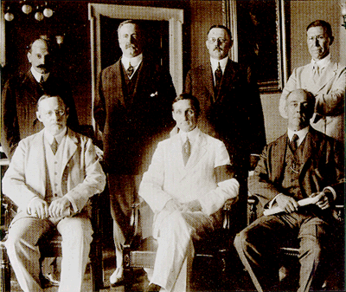
The Federal Reserve System
Meeting of the National Monetary Commission (NMC) in 1908
Creation of the Federal Reserve Act of 1913
The Original Board of Governors,
1914

Slide 4
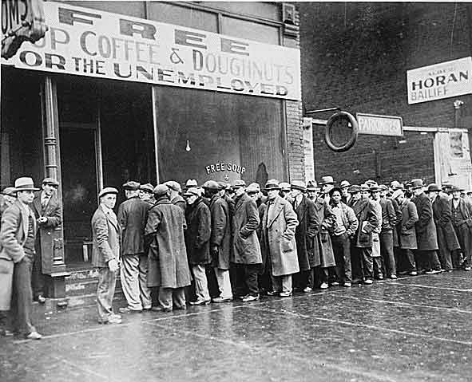
Early Problems
The Great Depression & Financial Crisis
  1930 to 1933
    One fourth of all banks failed
Reformed in 1935
  Centralization of Fed control

Slide 5
The FED Structure
Member banks own the Fed
Structure:
  Board of Governors
  District Banks
  Member Banks
    Federal Advisory Council (FAC)
  Federal Open Market Committee (FOMC)

Slide 6
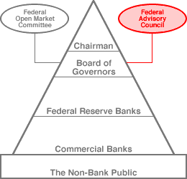
The Federal Reserve Hierarchy

Slide 7

Board of Governors
Headquartered in Washington, D.C.
7 members
  Appointed by the President
  Confirmed by Senate
  14 year staggered terms
Chairman of the Board
  President appoints Chair from among 7 members
  Senate Confirmation
    Four year, renewable term
Jerome Powell

Slide 8
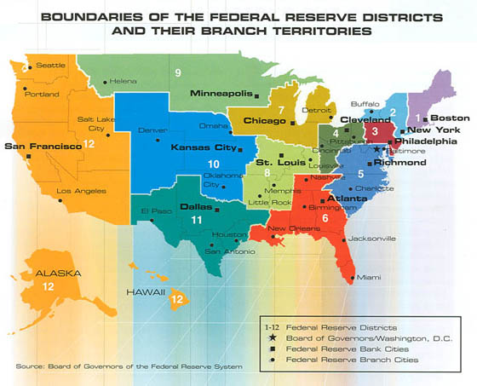
District Banks

Slide 9
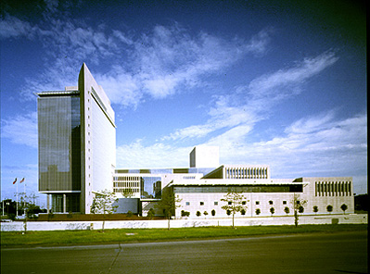
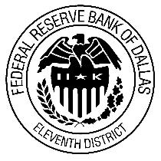
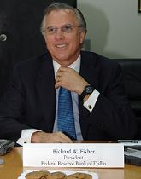
The Fed in Dallas, Texas
Richard W. Fisher
President of the Federal Reserve Bank of Dallas Member of the FOMC

Slide 10
District Banks
Board of Directors
    9 Directorships
        3 Bankers
        3 Leaders in industry
        3 Directors appointed by Federal Board of Governors
  The District President is elected from these 9 members
Duties
    Monitor & Report on economic and banking conditions within the district.

Slide 11


Member Banks
Who is a member of FED?
    All nationally chartered banks are required to become members
    State chartered banks have the option to join
      Approximately 4,000 members of the FED nationally

Slide 12
Member Banks
How to join:
    Apply and pay a fee
Benefits of Joining:
    Own stock in the system
      Earns dividends up to 6%
Is it bad if my bank is NOT a member?
    Not really…
    Since 1980, all banks have access to FED services:
        Check Clearing
        Short-Term Reserve Loans

Slide 13
Federal Advisory Council (FAC)
One member from each of the twelve FED districts sits on the council.
Duties:
    Meets with Federal Reserve Board of Governors four times a year.
    Collects info about economic conditions in each district
    Reports findings to BOG
    Offer feedback & advice to BOG

Slide 14
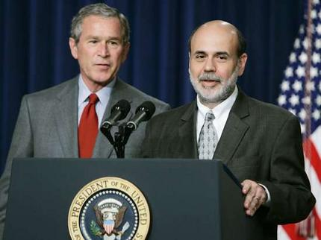
Federal Open Market Committee
12 Member Committee
    All seven members of the BOG
    Four of the twelve district bank presidents
      Serve one-year terms on a rotating basis
    New York district president has a permanent seat
Duties:
    Discuss cost & availability of credit, for businesses and consumers.
    Decide on interest rates
    Evaluate the growth of the money supply
    Meet 8 times/year
        Bernanke will hold a press conference announcing the FOMC findings

Slide 15

Federal Reserve Functions
Serves the Government
  Federal government’s banker
  Buys and sells securities (bonds) for the Federal government
  Issues currency

Slide 16
Federal Reserve Functions
Serves Banks (bankers bank)
  Makes loans
  Accepts deposits
  Clears checks

Slide 17
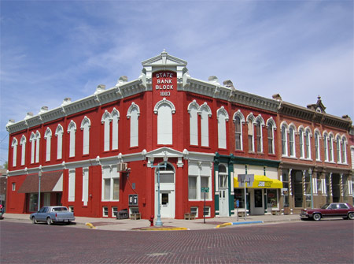
Federal Reserve Functions
Regulates the Banking System
  Monitors banks to ensure that the required reserves are available.
  Conducts bank examinations.
  Supervises lending
  practices

Slide 18

Federal Reserve Functions
Regulates the Money Supply
  The Fed must insure that enough money is in circulation to meet money demand.
  But too much money can cause inflation

